Slide 1

PROBABILITY & STATISTICS

Slide 2
INTRODUCTION
When the data are in original form, they are called raw data.
The most convenient method of organizing data is to construct the frequency distribution.
A frequency distribution consists of classes and their corresponding frequencies.

Slide 3
Organizing Data
Each raw data value is placed into a quantitative or qualitative category called a class.
The frequency of a class then is the number of the data values contained in a specific class.

Slide 4
Frequency Distribution
It is the organization of raw data in table form, using classes and frequencies.
Two types of frequency distributions that are most often used are the:
Grouped frequency distribution
Categorical frequency distribution

Slide 5
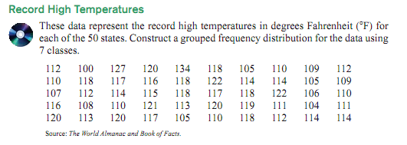
Grouped frequency distributions

Slide 6
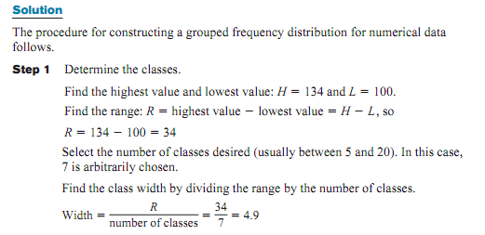
Solution

Slide 7
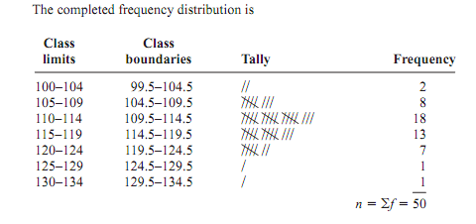

Slide 8
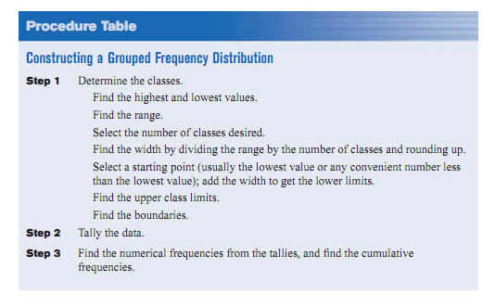

Conclusion

Slide 9
Cumulative frequency distribution
It is a distribution that shows the number of data values less than or equal to a specific value (usually an upper boundary)

Slide 10
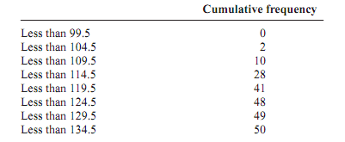

CFD

Slide 11
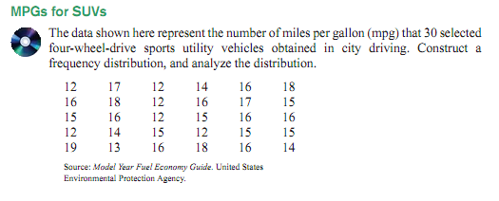
Ungrouped frequency distribution

Slide 12
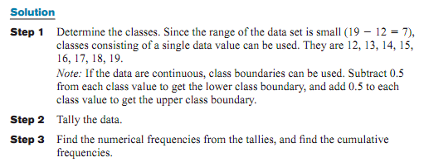
Solution

Slide 13
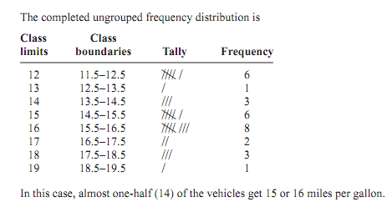

Slide 14
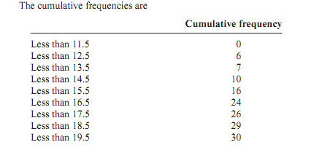
CFD

Slide 15

Categorical frequency distribution

Slide 16
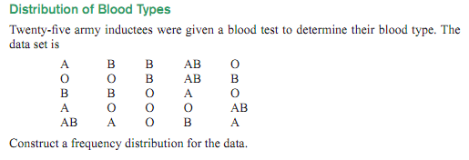
Example

Slide 17
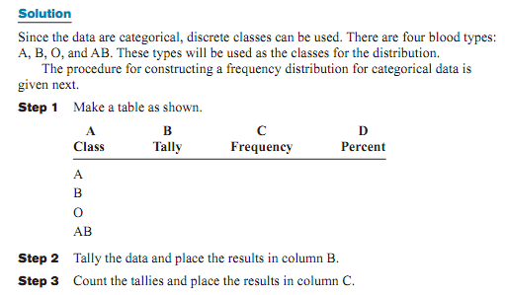
Solution

Slide 18
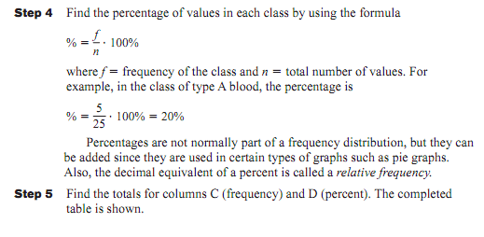

Slide 19
